Slide 1


Titolo presentazione sottotitolo
PERSONAS CREATION AND SpesaAmica SERIOUS GAME
Milano, XX mese 20XX
Airaghi Simone, Gianfranceschi Anna, Girimonte Ilaria, Giuffrida Lucia, Lenoci Alessia

Slide 2



INTRODUCTION: PYHTON PART
INTRODUCTION
1
4
DATA REDUCTION
PREPROCESSING
2
5
STATISTICAL ANALYSIS
STANDARDIZATION
6
3
RESULTS

Slide 3





INTRODUCTION: SERIOUS GAME

Slide 4
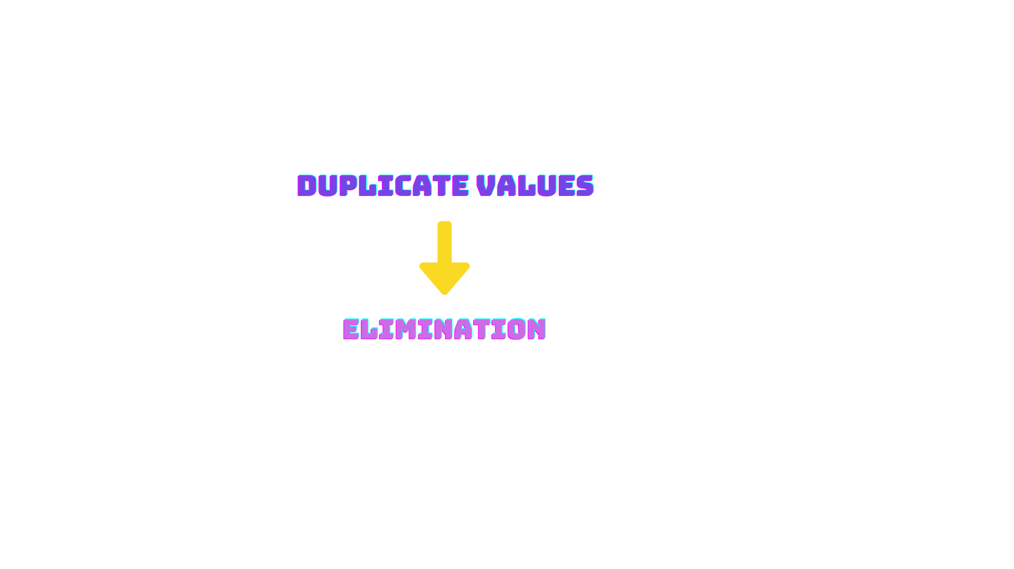
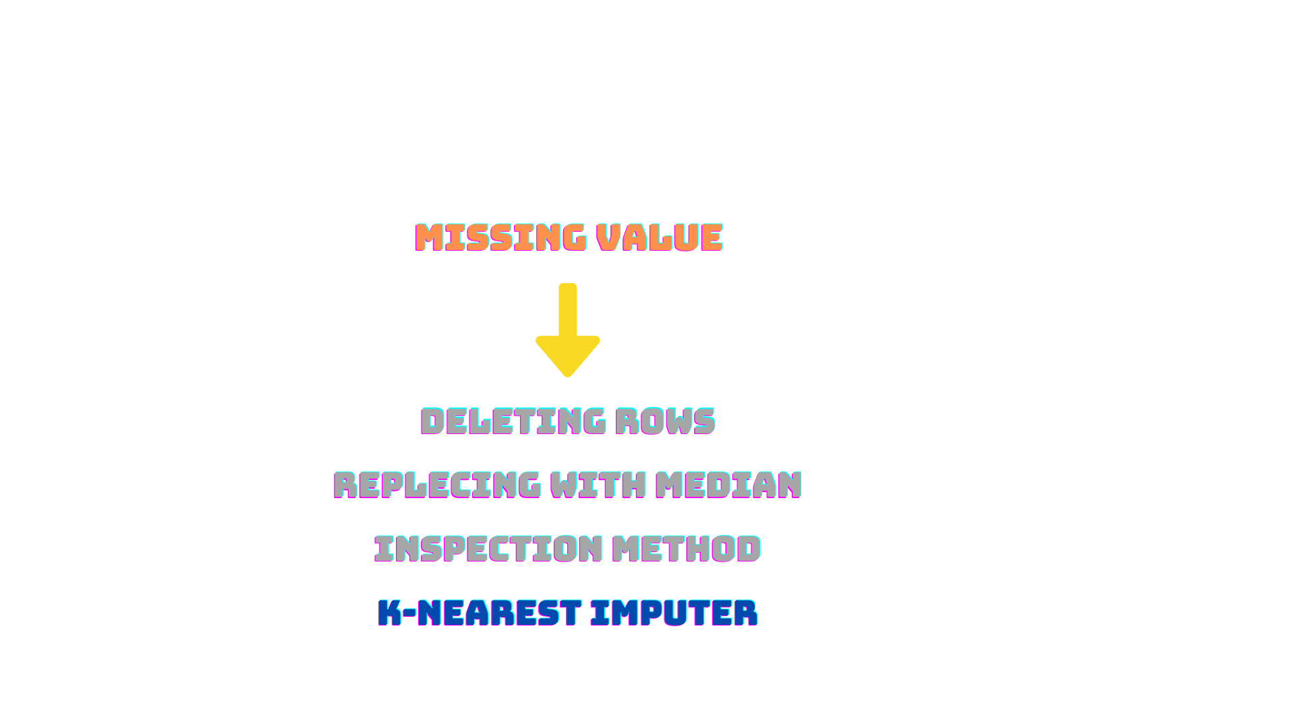

PREPROCESSING

Slide 5


STANDARDIZATION
For K-Nearest imputer
For avoiding cluster's bias due to ‘income’ variable
ROBUST SCALER
STANDARD SCALER
MIN-MAX METHOD

Slide 6

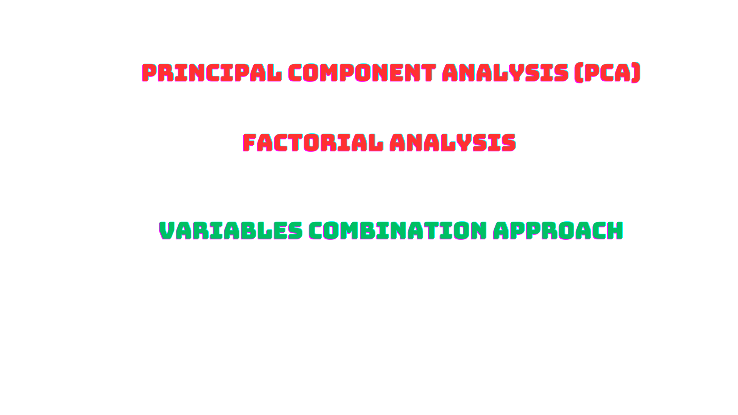

DATA REDUCTION AND FEATURES CONSOLIDATION
Relevant principal components, able to explain a significant portion of the dataset’s variance, were not identified.
Less interpretable
The relationship between factors and some initial features was lost
Strategy that led to the best results

Slide 7
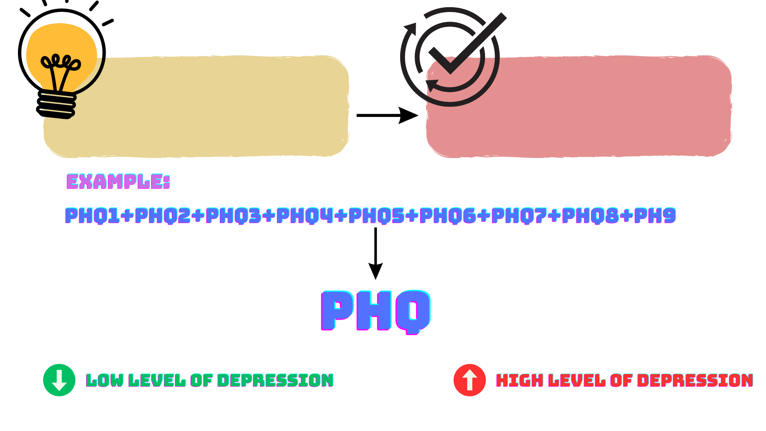
DATA REDUCTION: VARIABLE COMBINATION APPROACH
Logic: aggregating all the variables belonging to each questionnaire
Result: obtaining a unique feature for each group
Interpretation of the resulting variable:

Slide 8

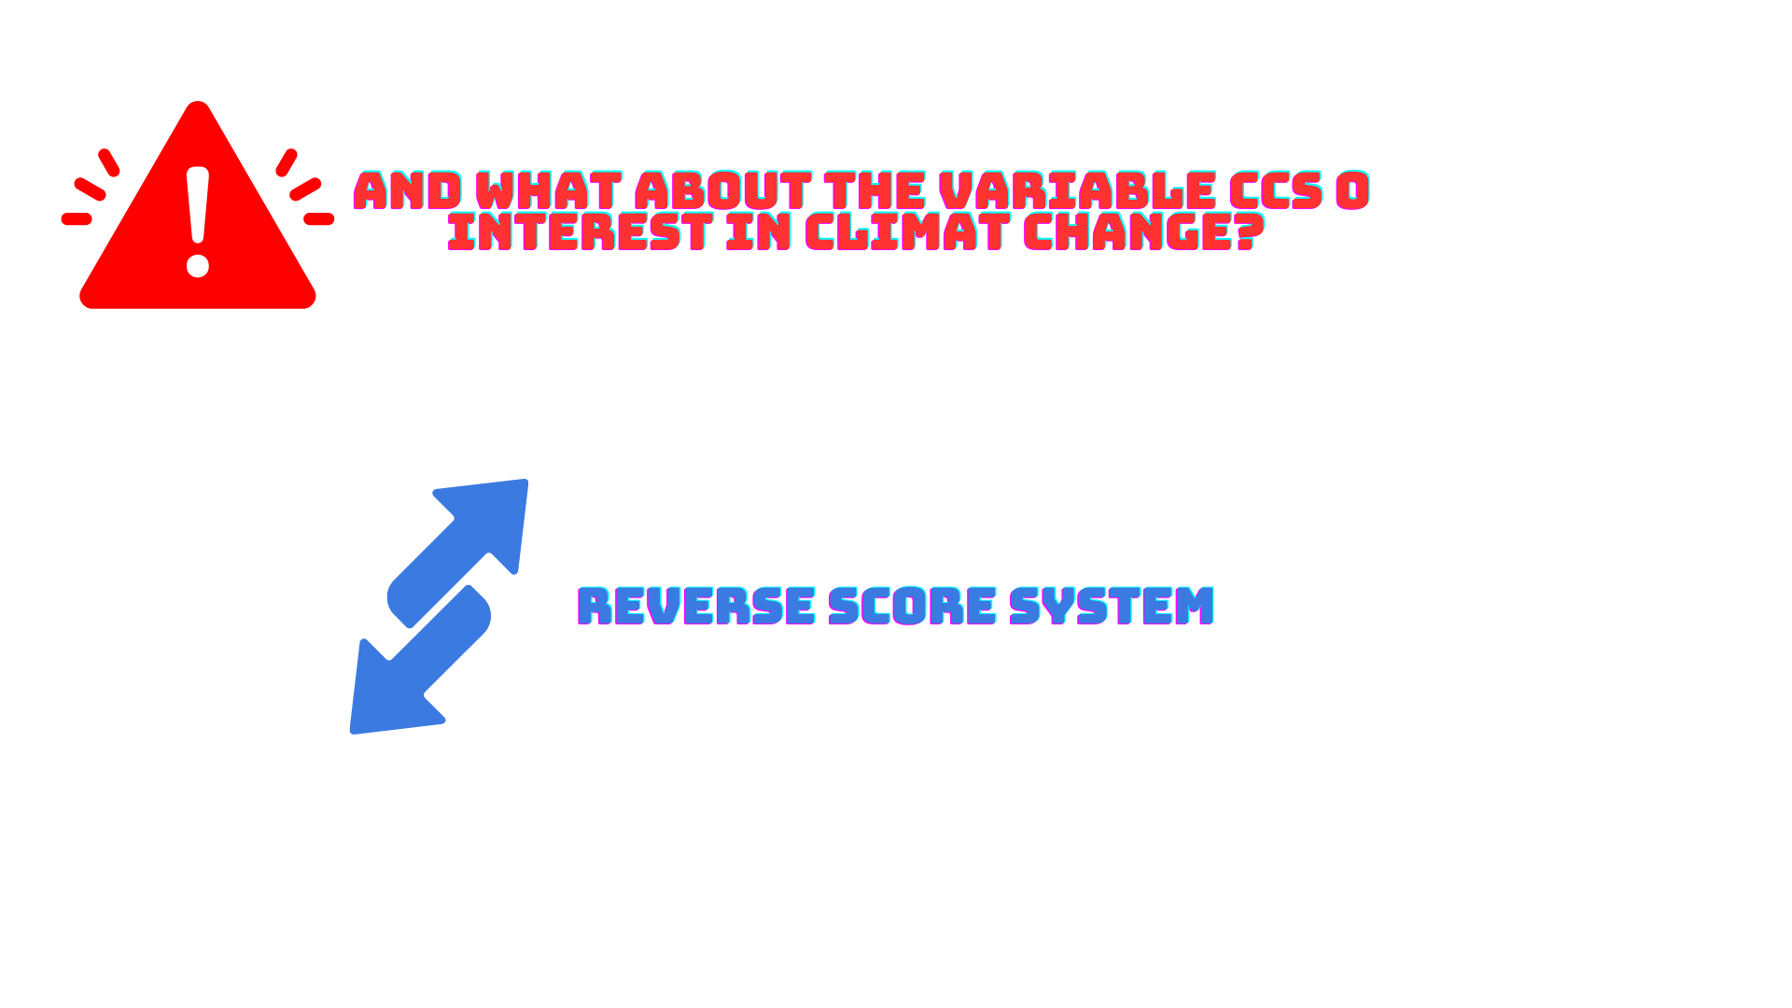
DATA REDUCTION: VARIABLE COMBINATION APPROACH

Slide 9
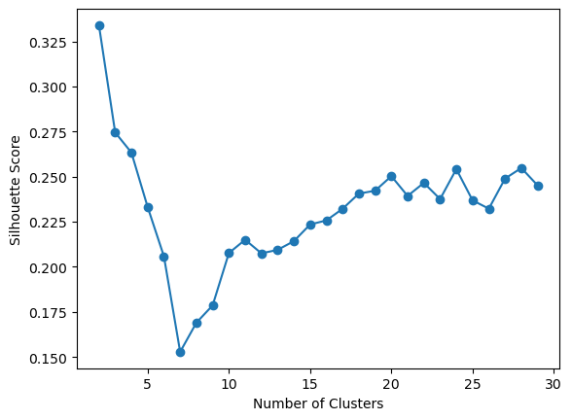

CLUSTERING METHOD SELECTION
K-Means Clustering
K-Medoids Clustering
Agglomerative Clustering
Analyzing Silhoutte values for various number of clusters, it emerged that with the use of 3 clusters the best result could have been obtained
K-Means Clustering

Slide 10
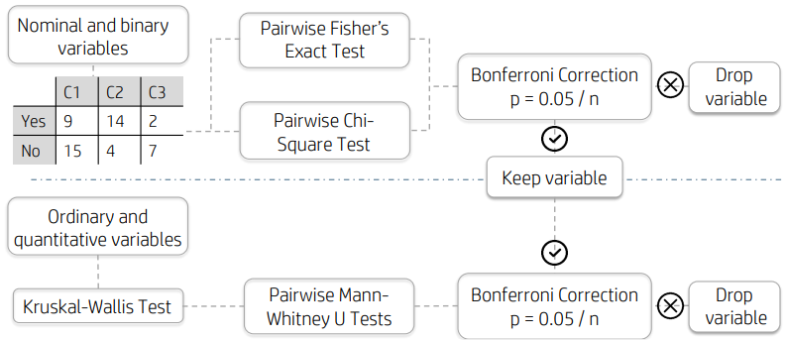
STATISTICAL ANALYSIS

Slide 11
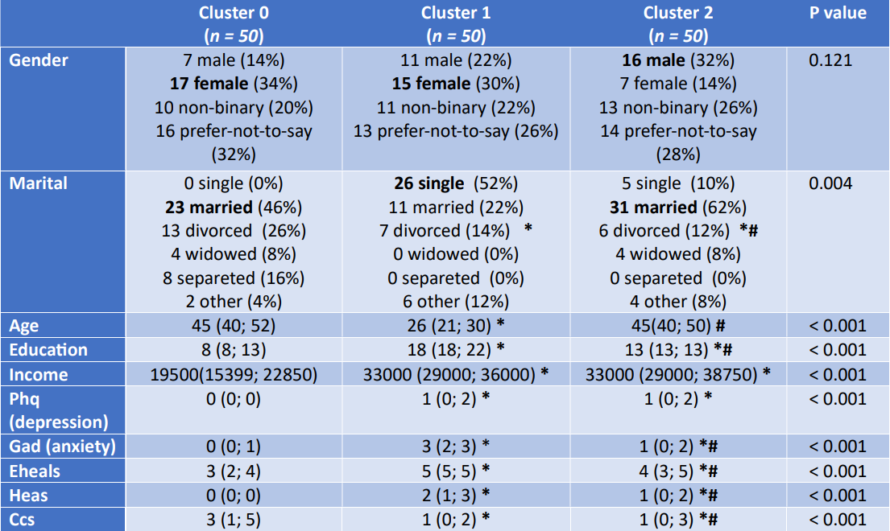
FINAL RESULTS

Slide 12
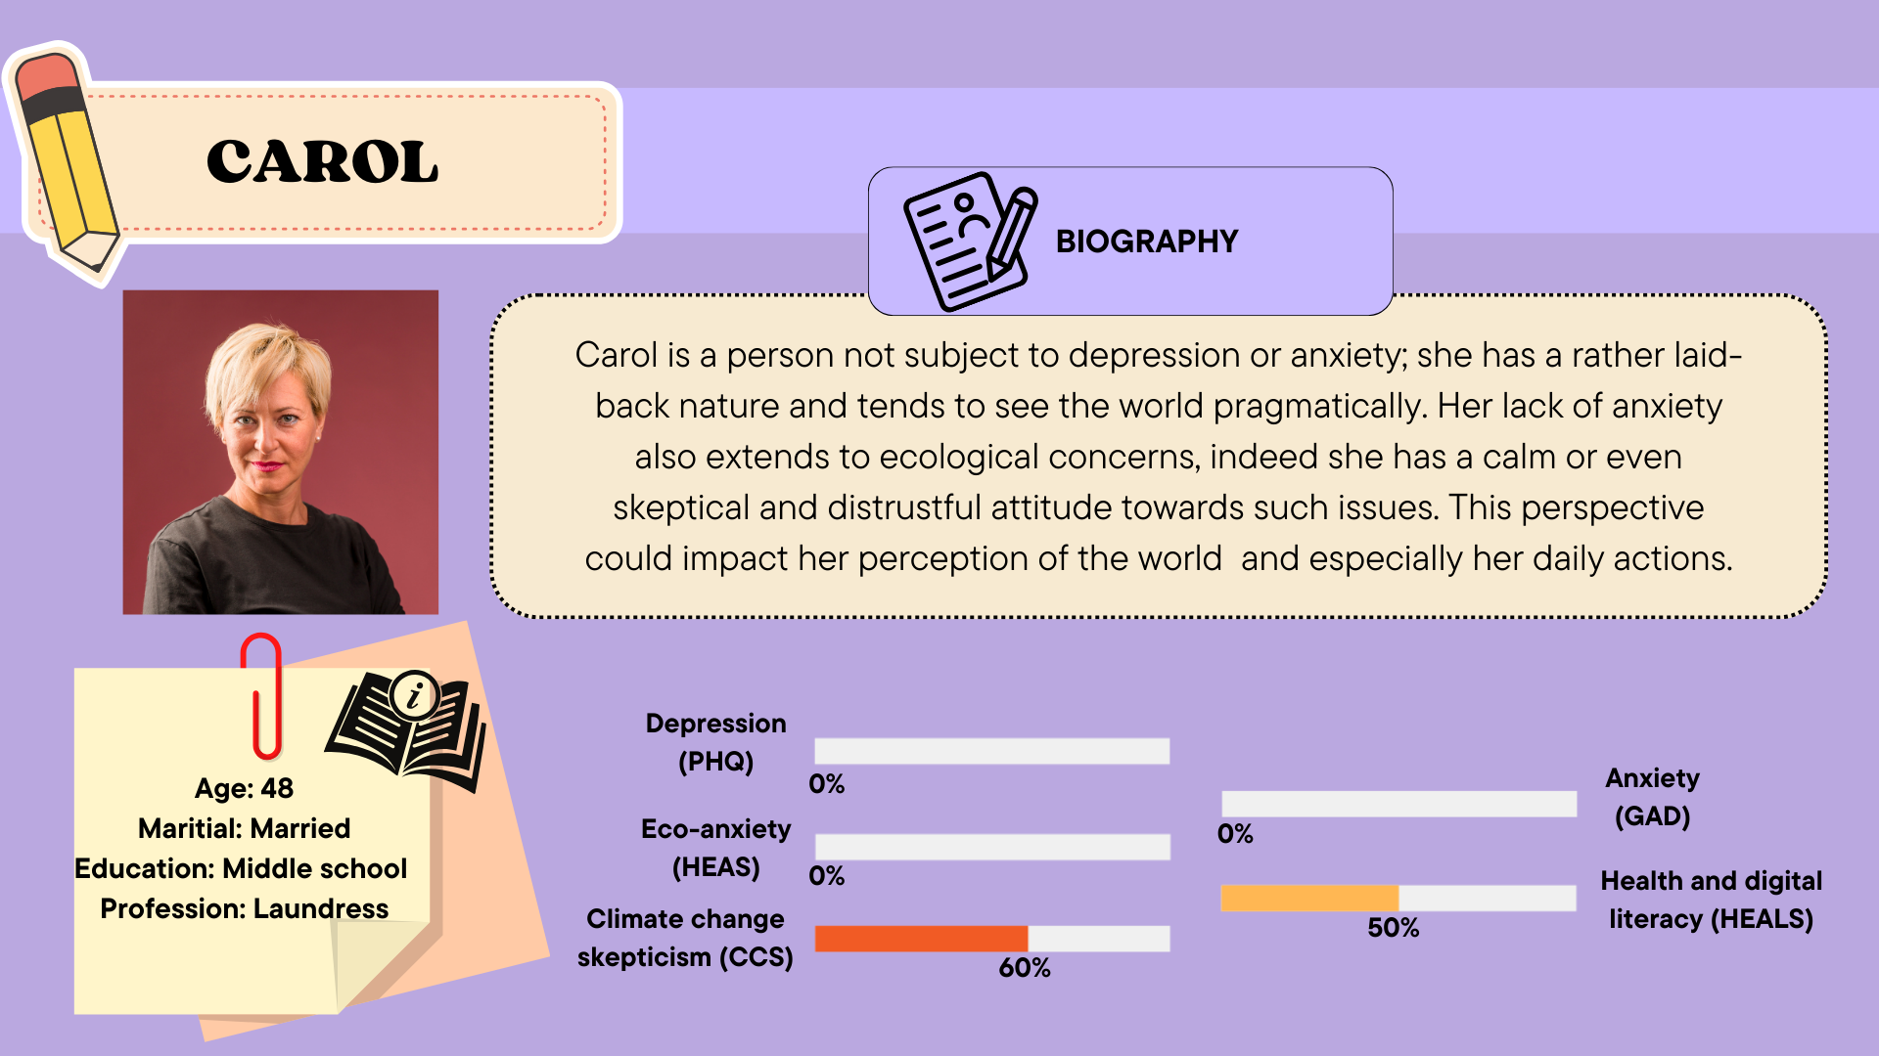
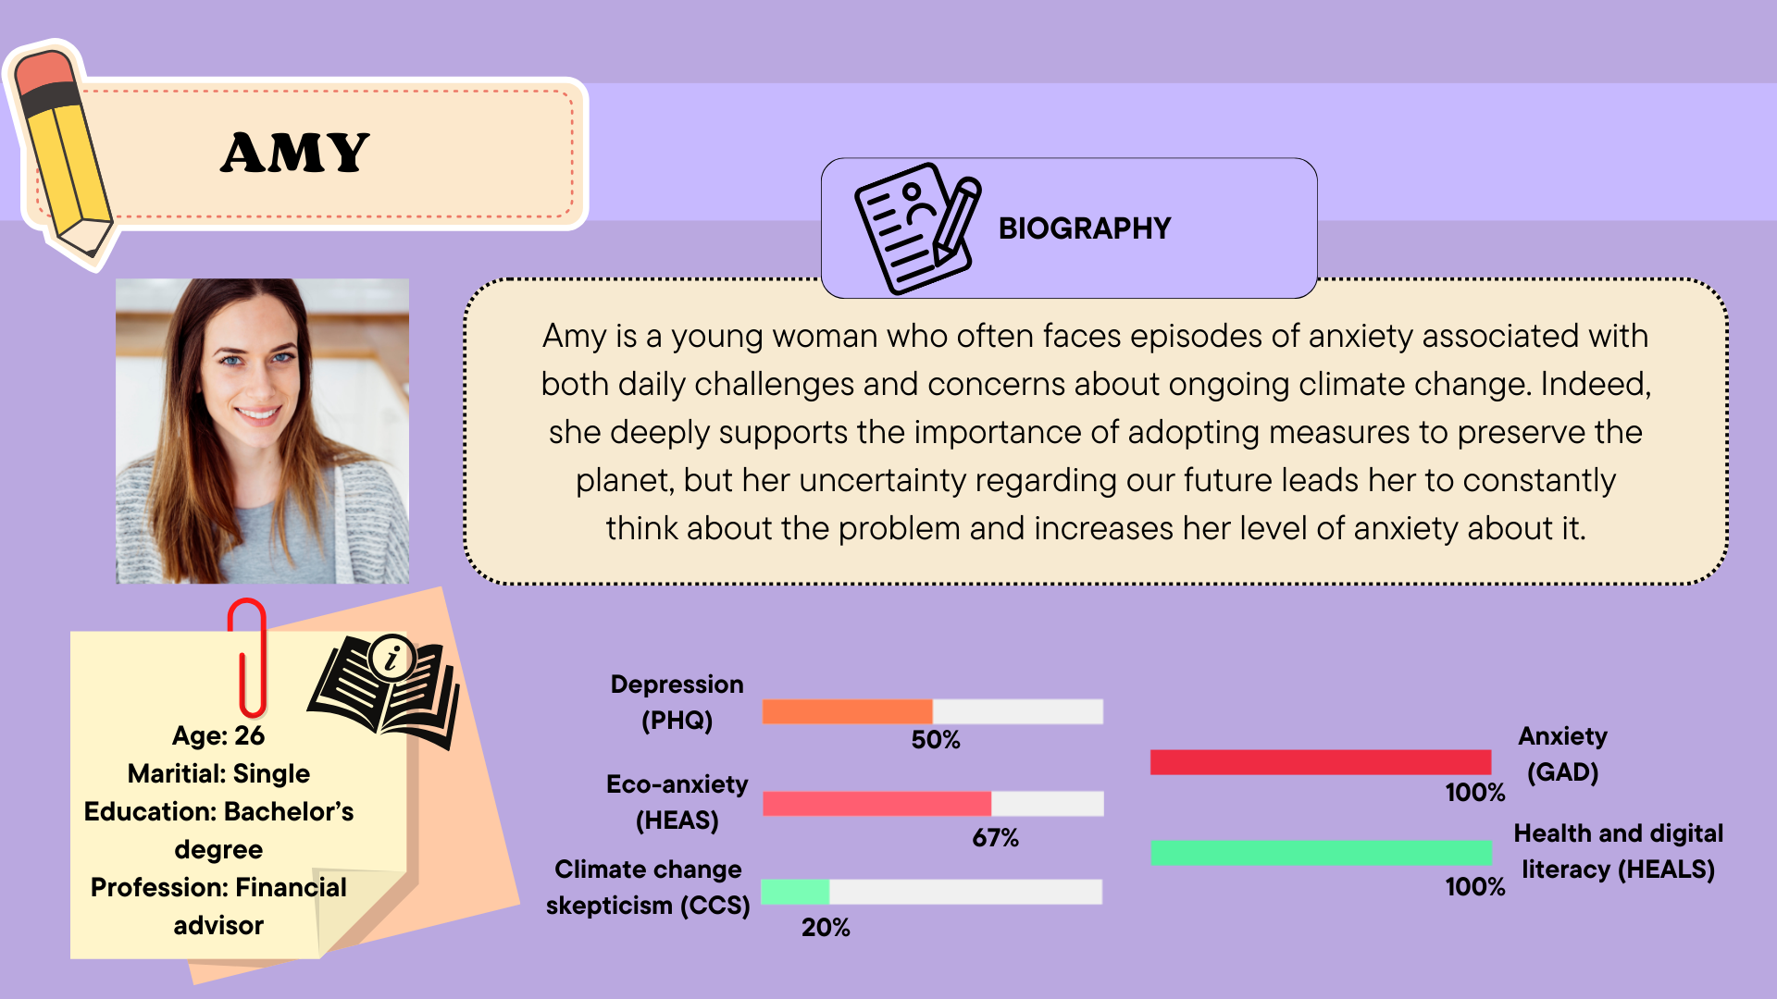
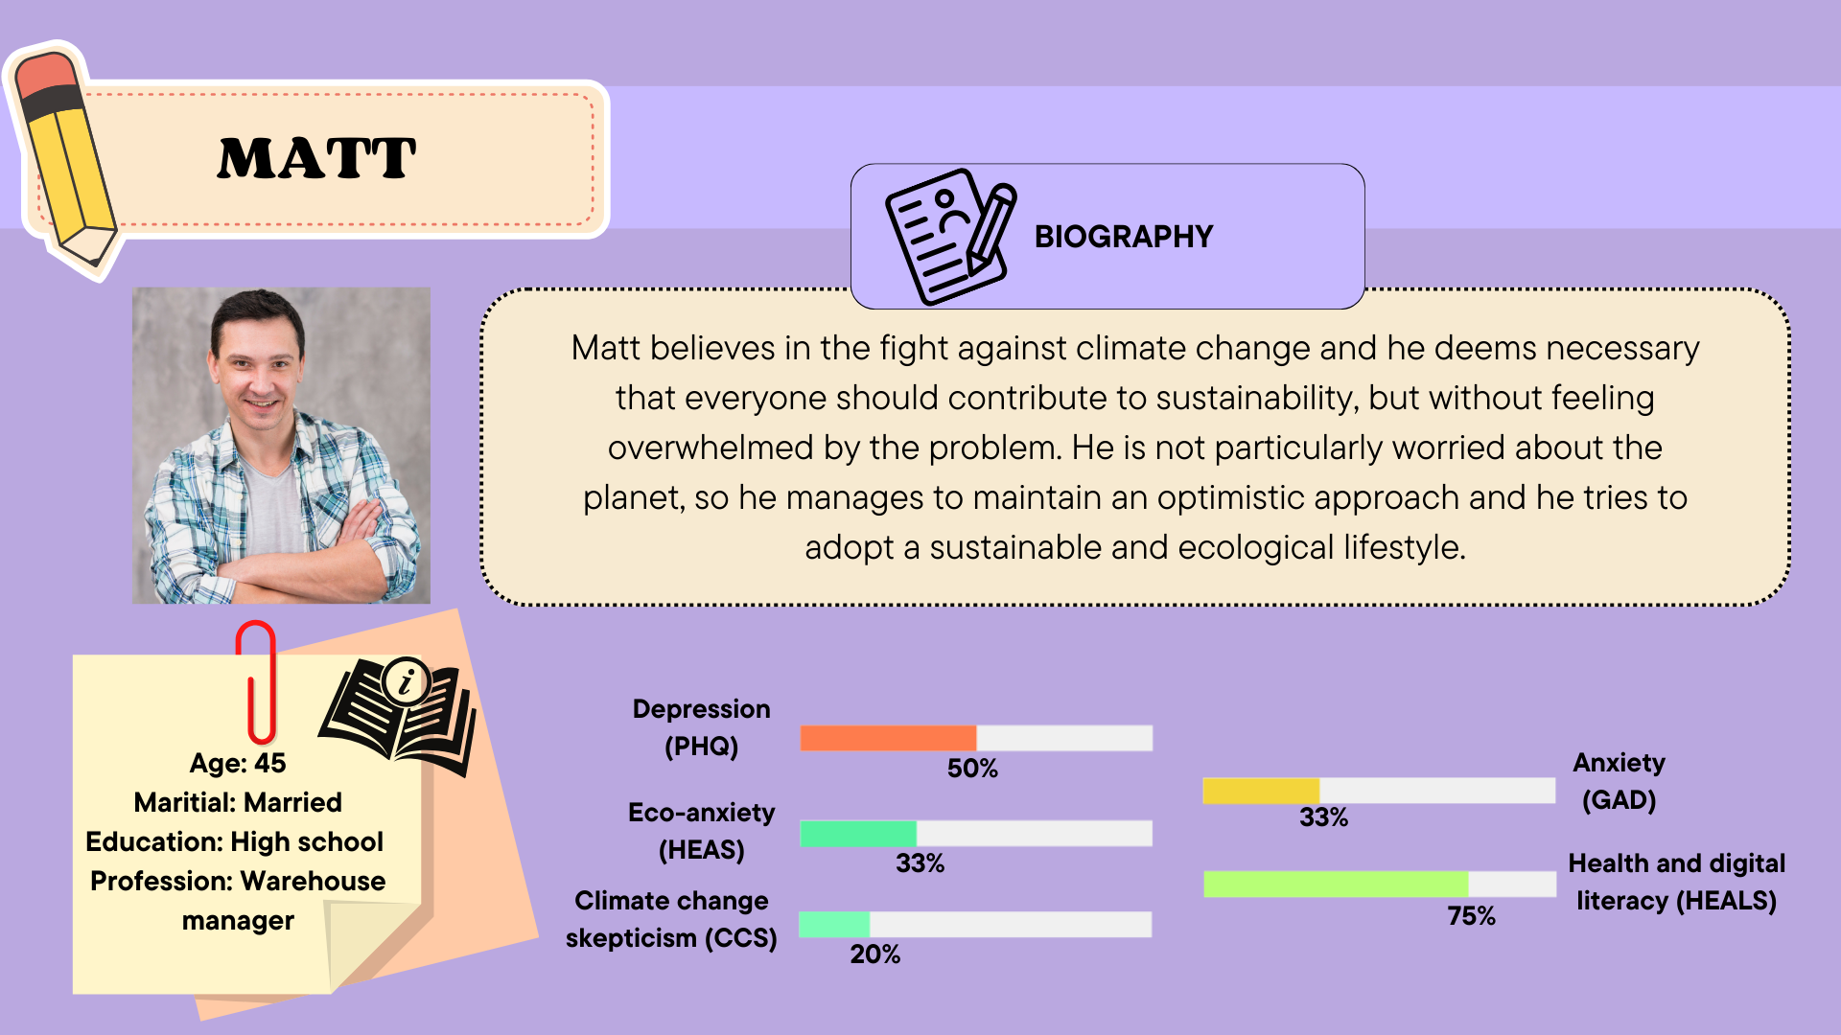
FINAL RESULTS

Slide 13

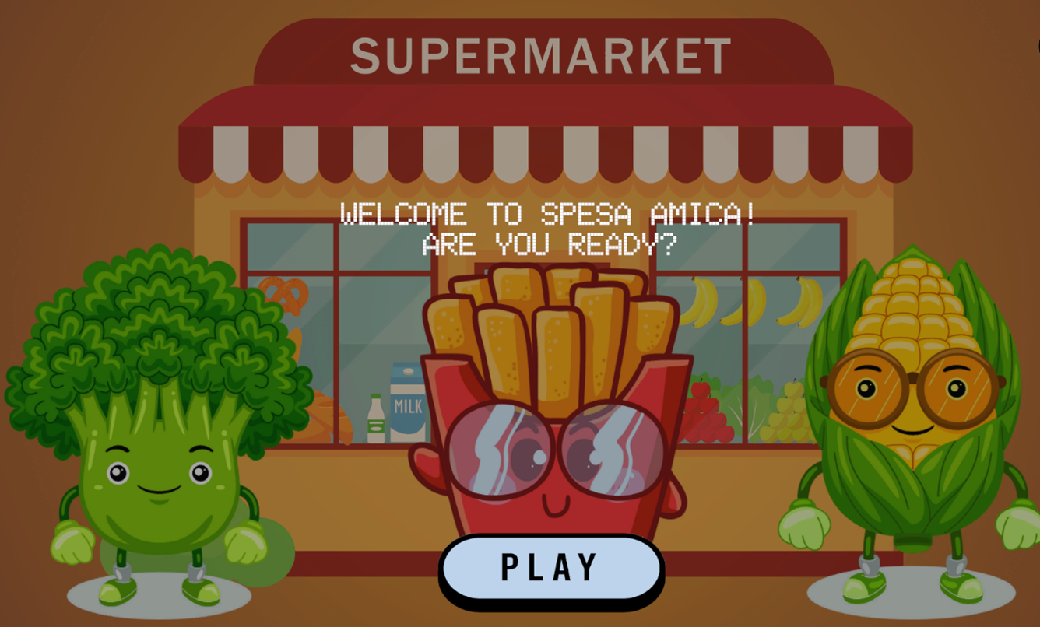
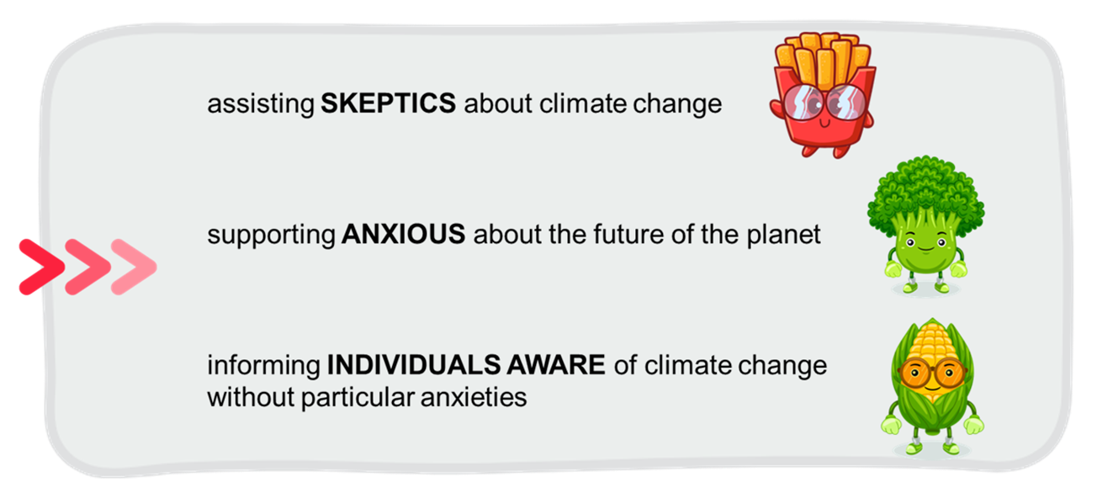
GAME CONCEPT: "SpesaAmica"
MAIN GOAL
Make people more conscious about how their daily life choices influence the environment
why?
to allow players to gain a deeper understanding of climate change
how?
experiencing the impacts of their decisions in a virtual setting

Slide 14

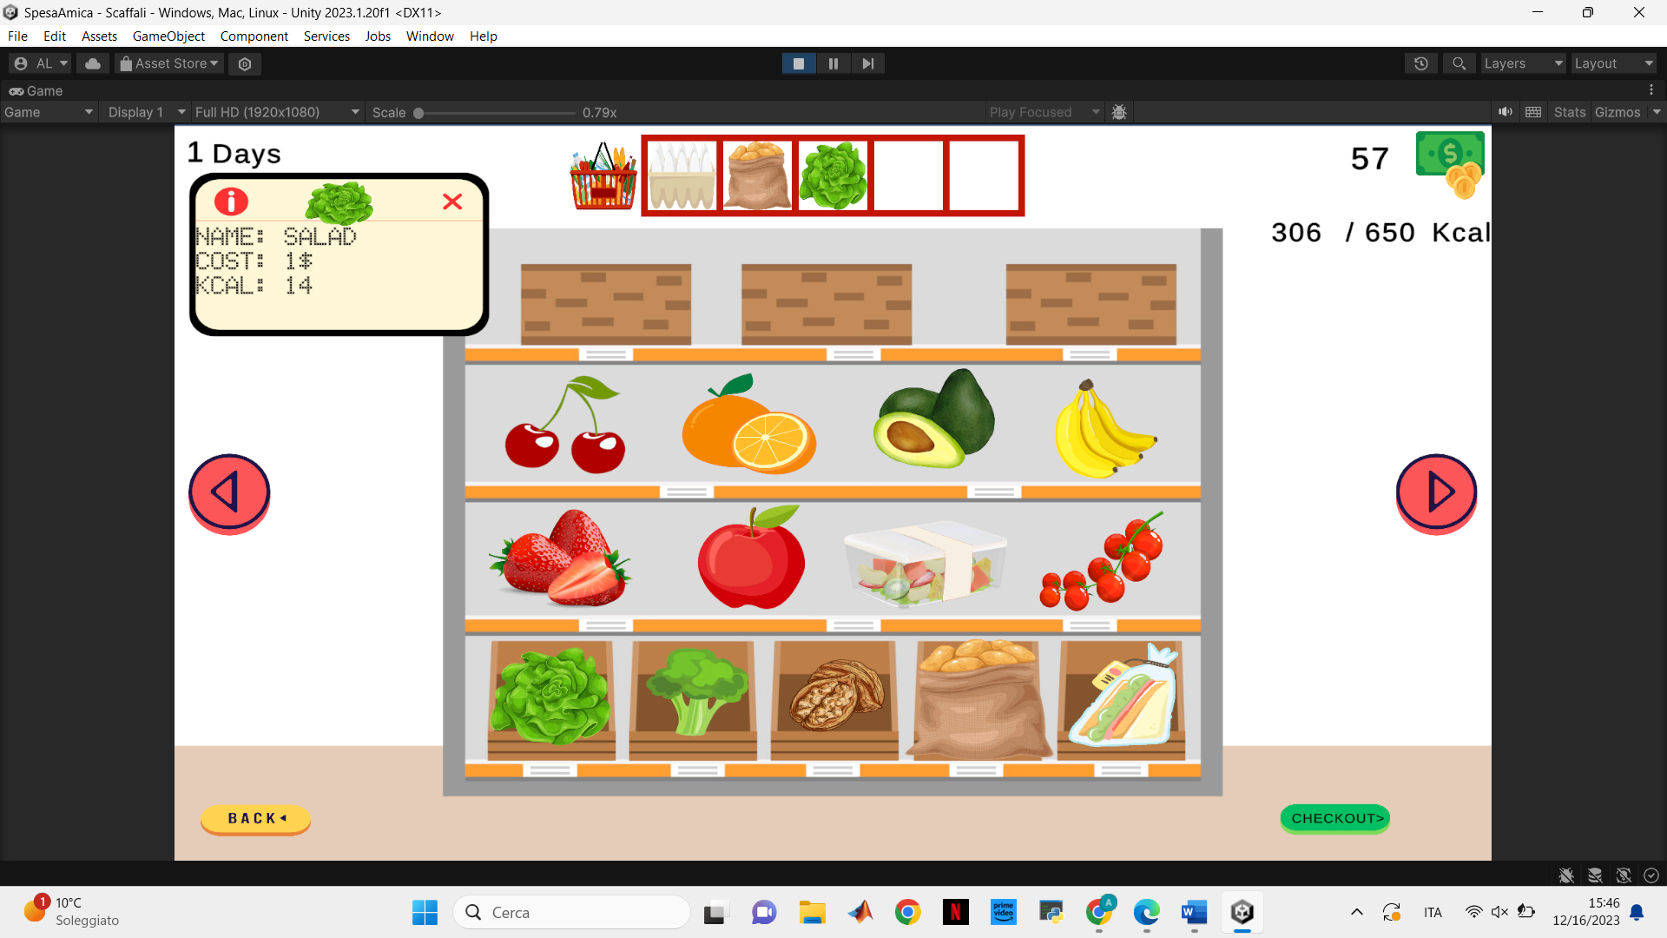

HEART OF THE GAME
3 shelves:
proteins
vegetables
generic products
for a total of 39 items

Slide 15
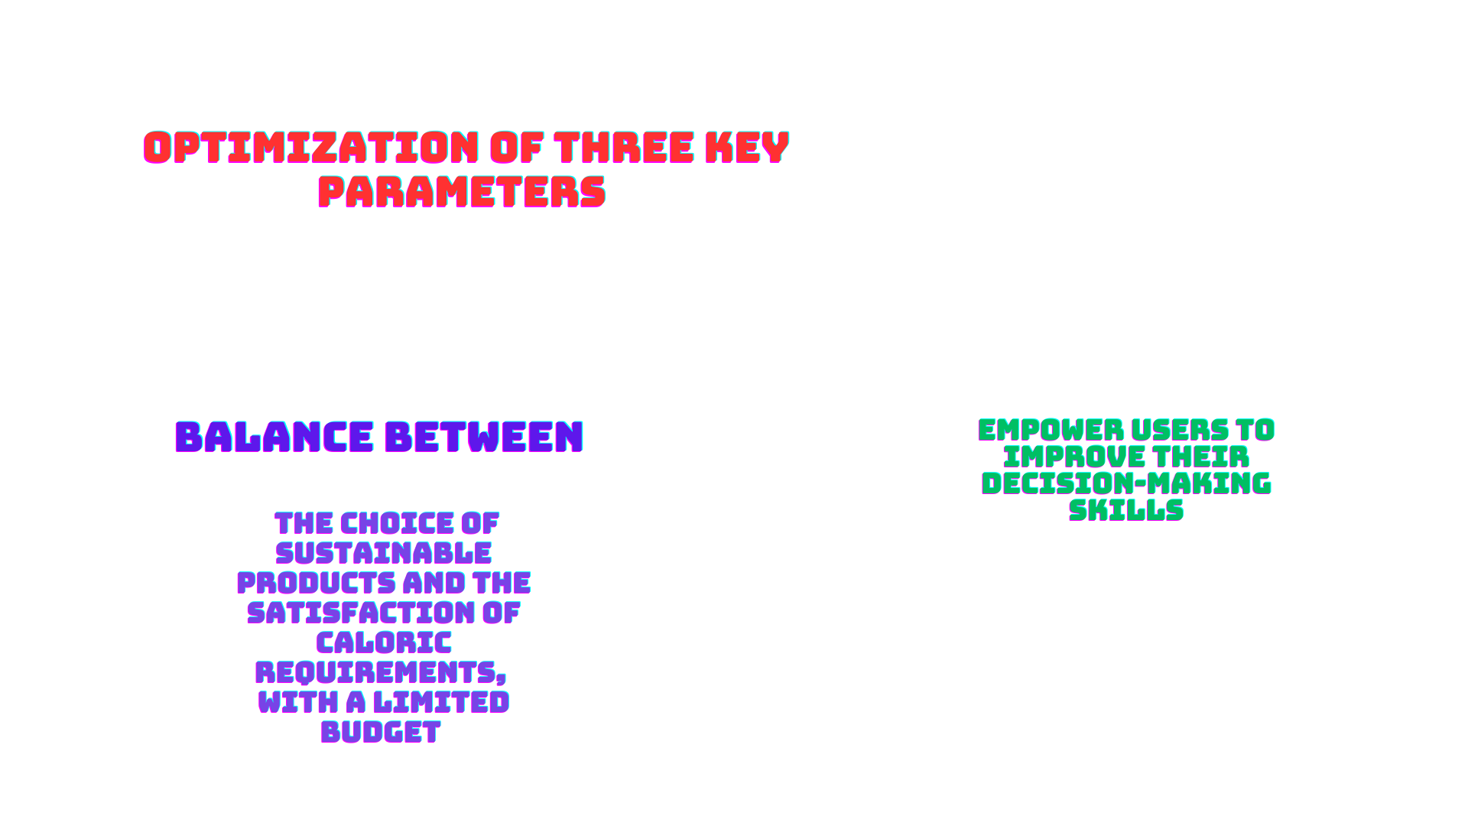
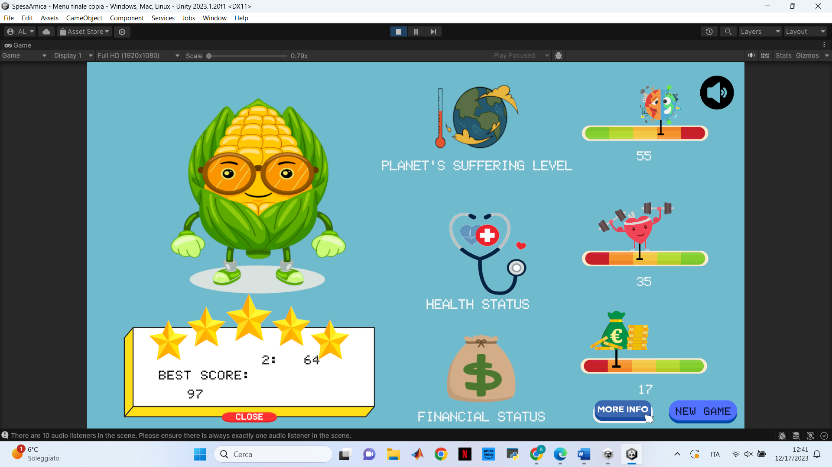

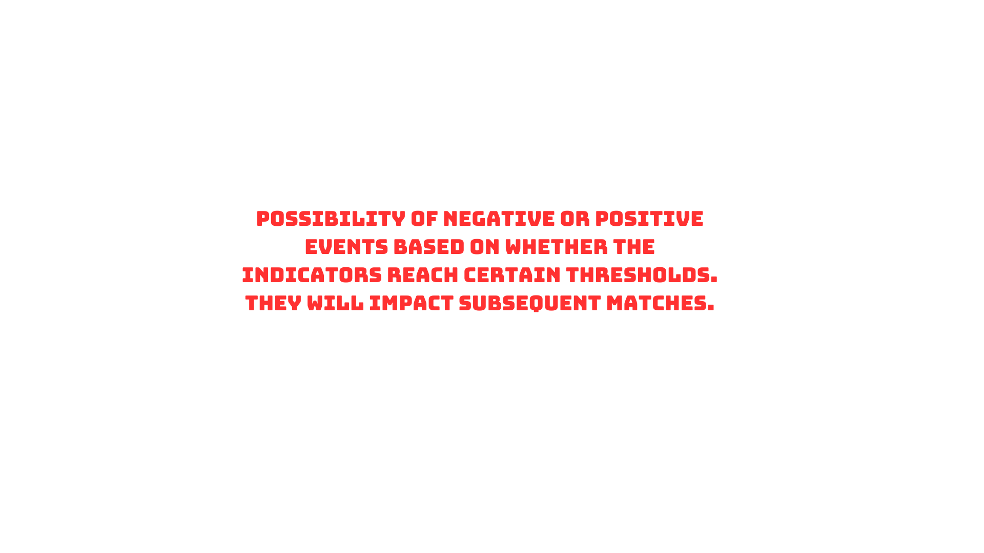
OPTIMIZATION GAME

Slide 16
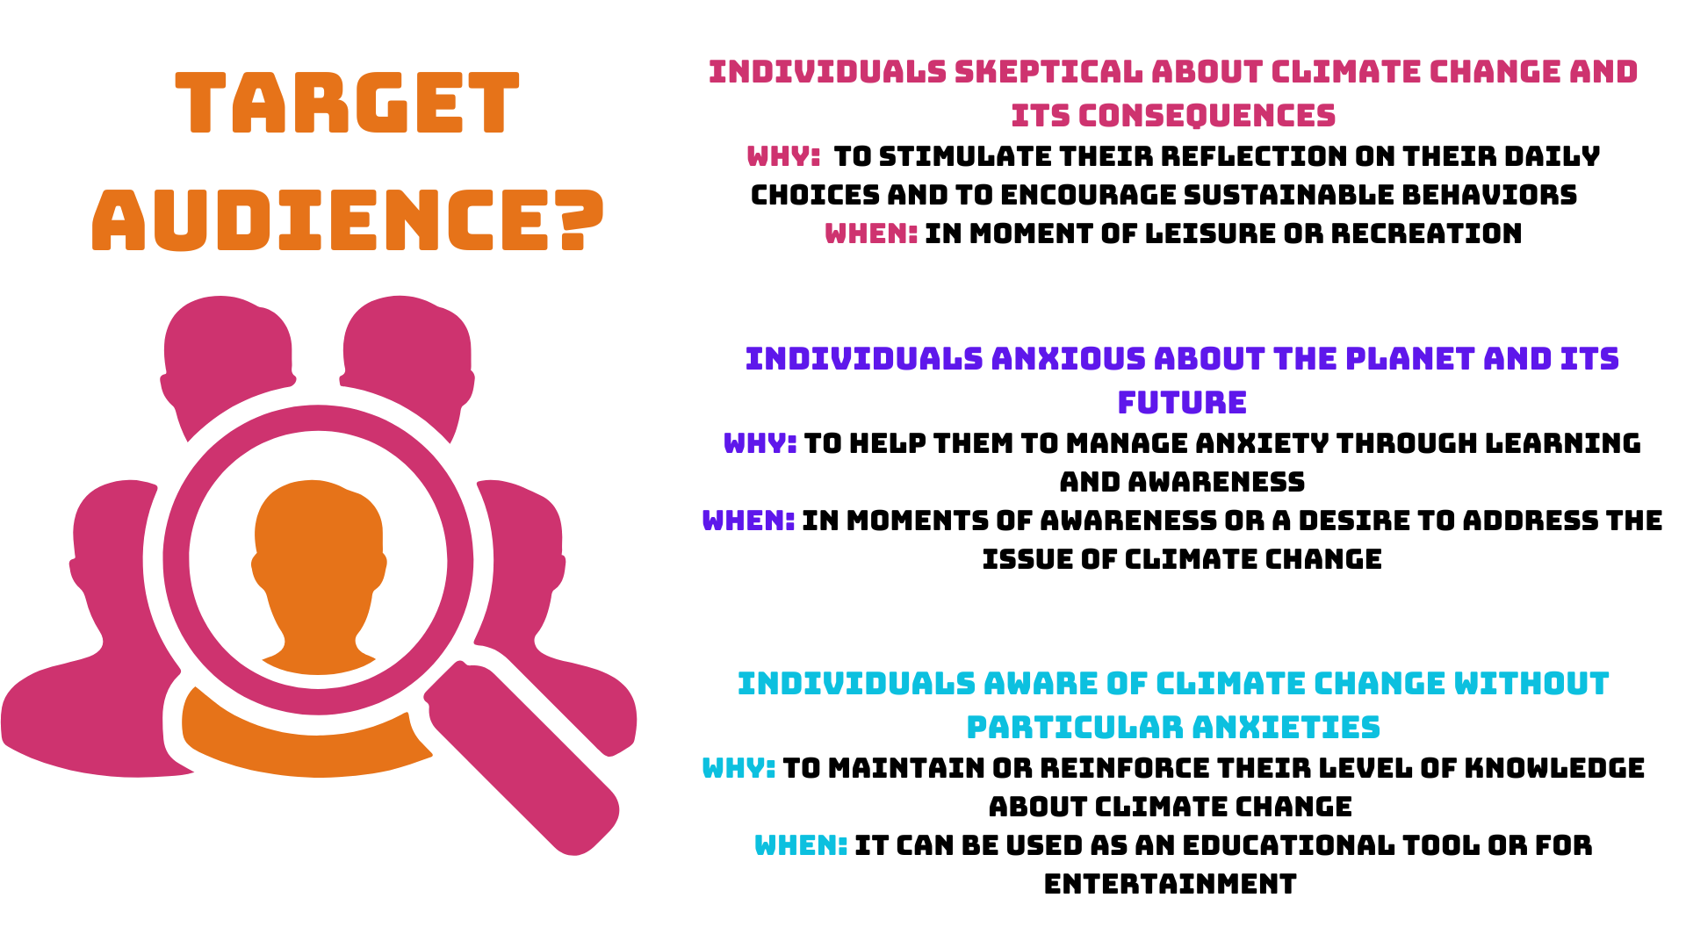
TARGET AUDIENCE AND USE CASES

Slide 17



PERSONALIZATION TECHNIQUES
People aware of climate change but without anxiety
People skeptical about climate change
People who experience anxiety about this issue

Slide 18
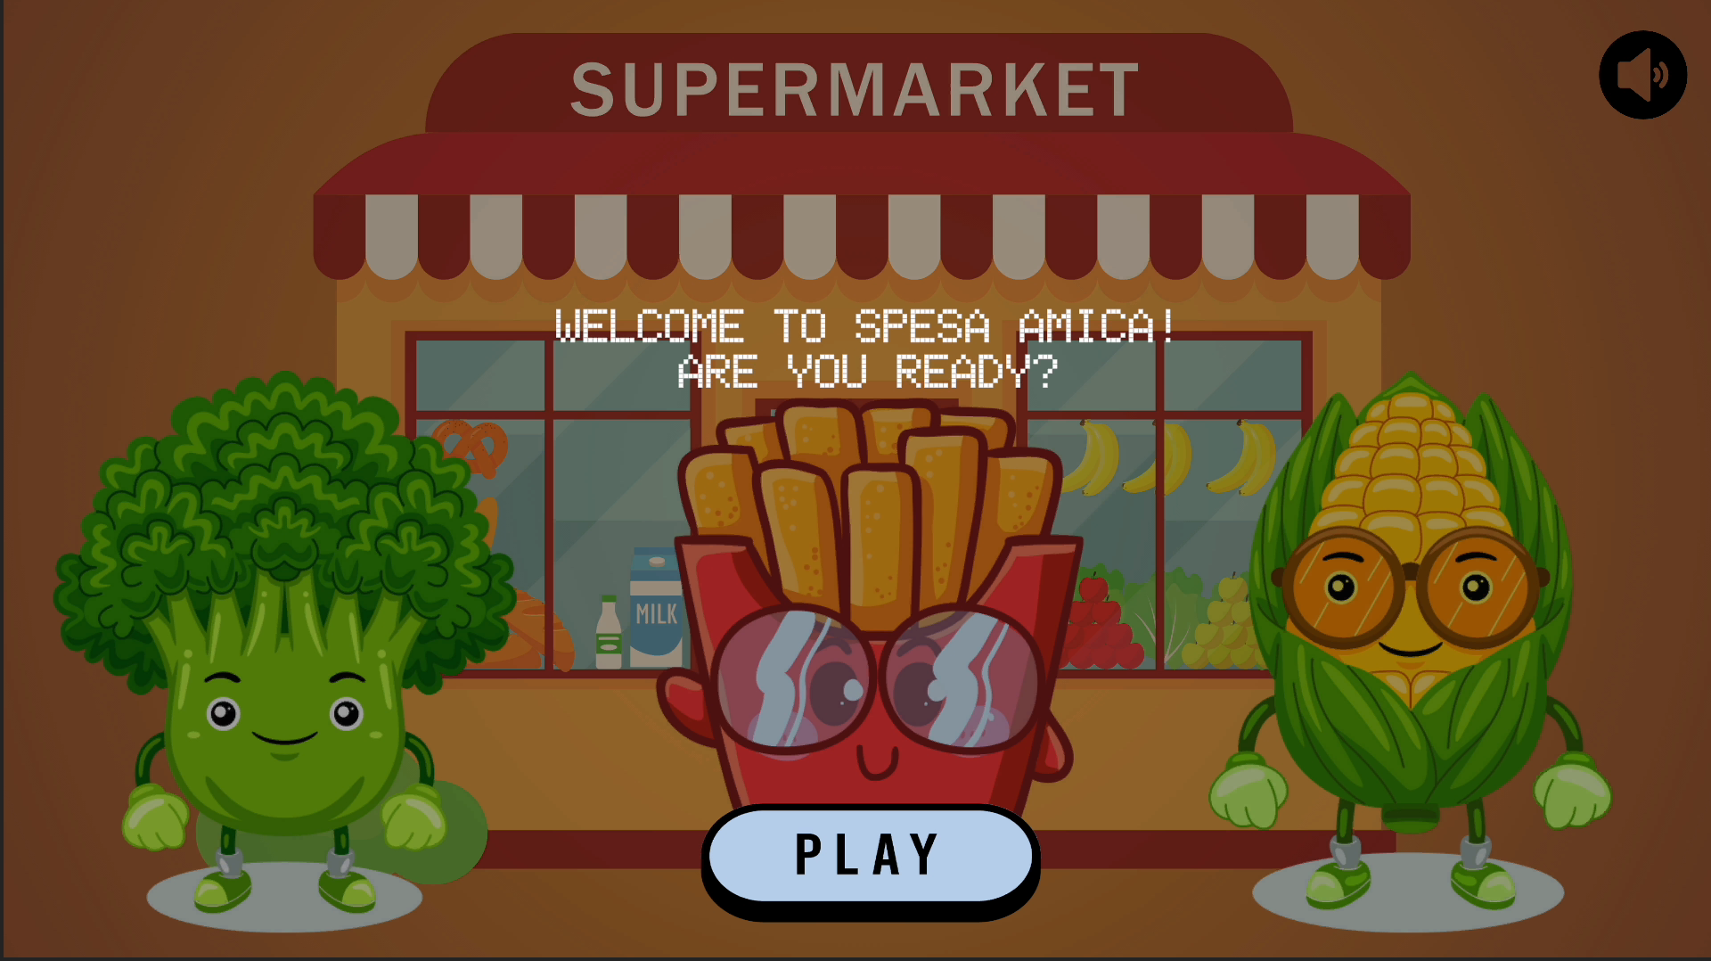
DEMO CHARACTERS SELECTION

Slide 19

GAME DIFFERENTIATION

Slide 20

EVENTS DIFFERENTIATION
Intermediate
Skeptic
Eco-Anxious
Message in the middle between the two
Severe and catastrophic events
Soft negative messages
Positive message in the middle between the two
Also positive but less pronunced with respect to other categories
Particularly positive in order to alleviate the anxiety

Slide 21


NEGATIVE AND POSITIVE EVENTS
Price increases
Fines
Products no longer available
Discounts
Economic bonuses
Caused by:
Climate deterioration
Catastrophic events
Caused by:
Resource abundance

Slide 22
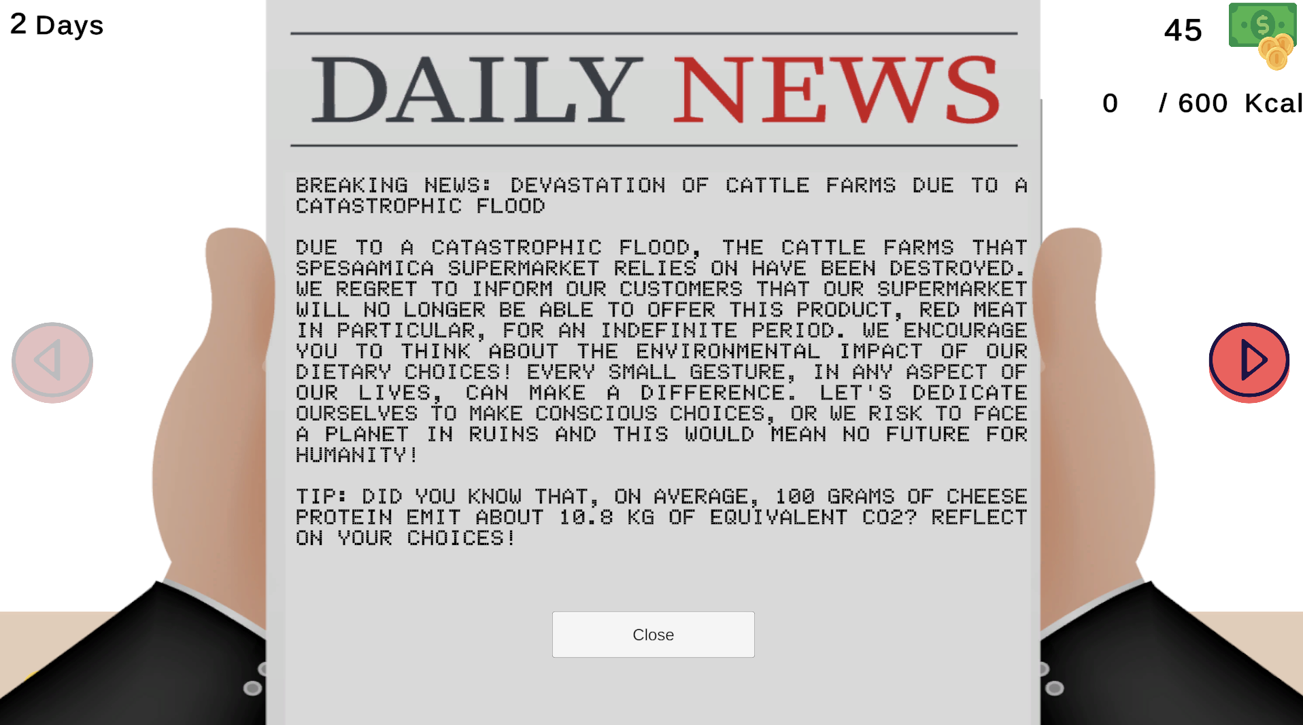
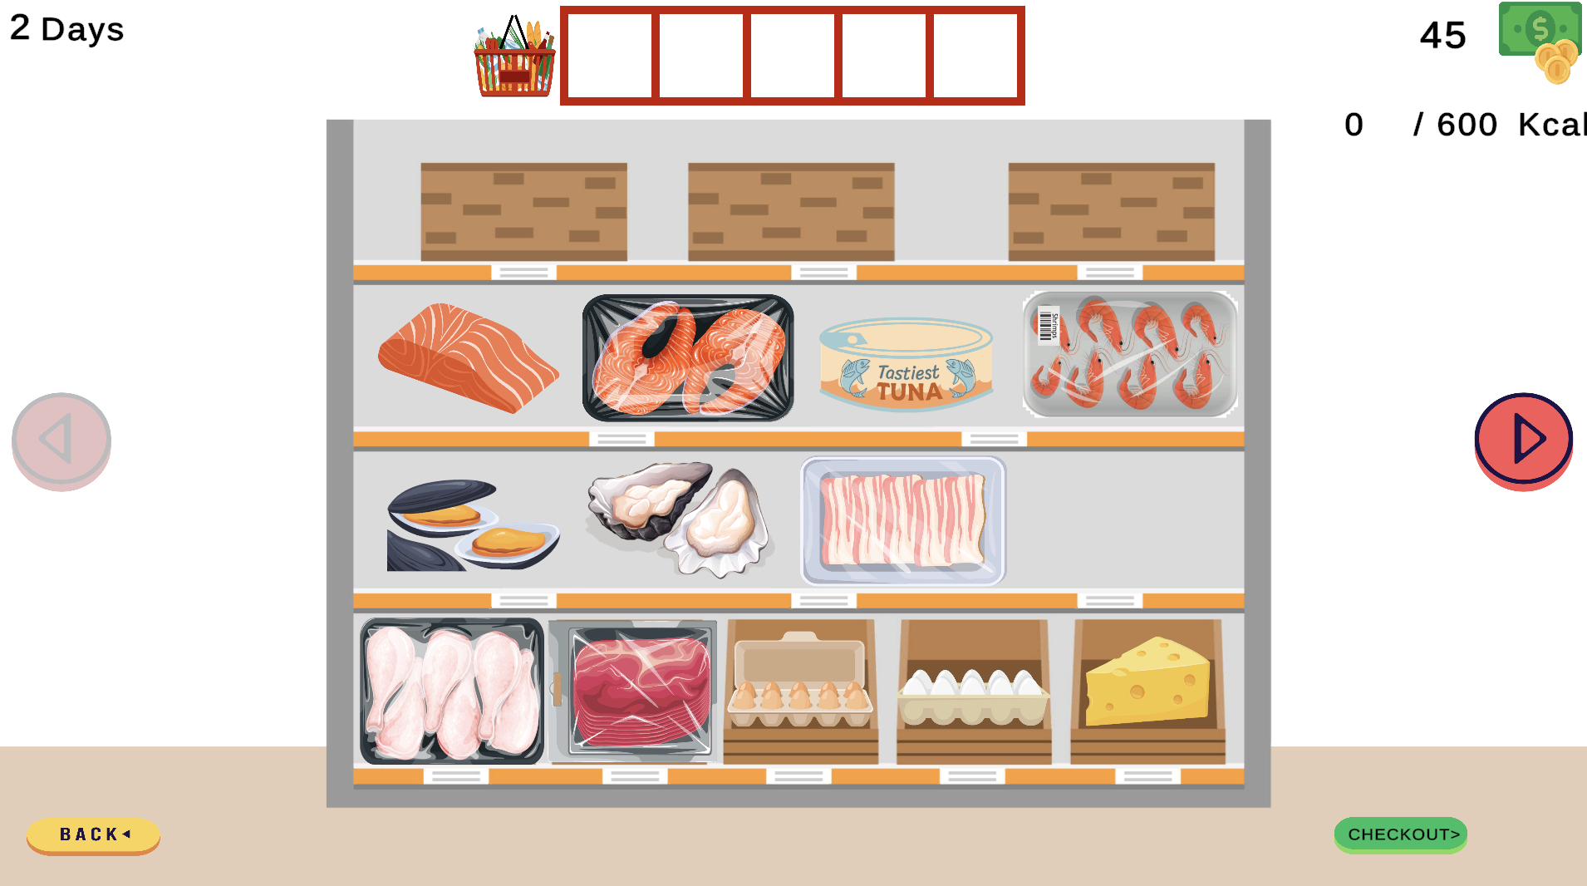
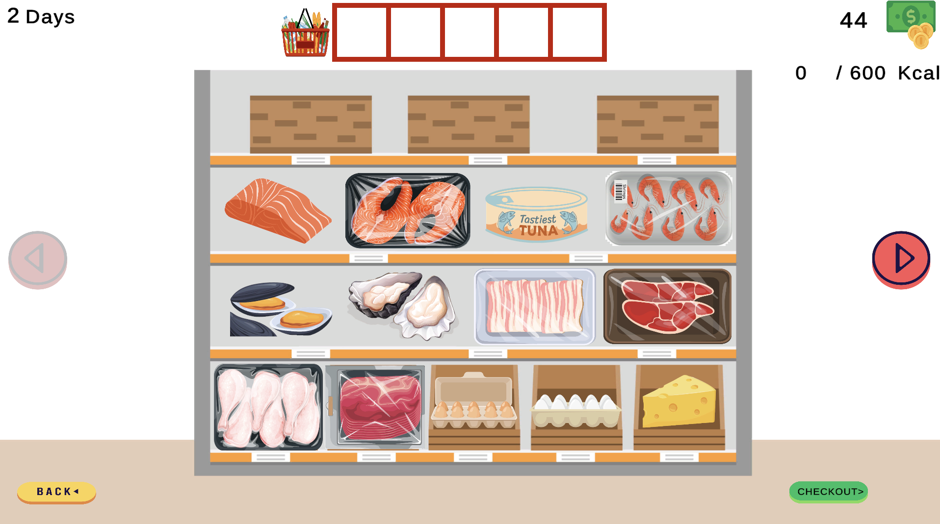
EXAMPLE OF A NEGATIVE EVENT FOR SKEPTICAL

Slide 23
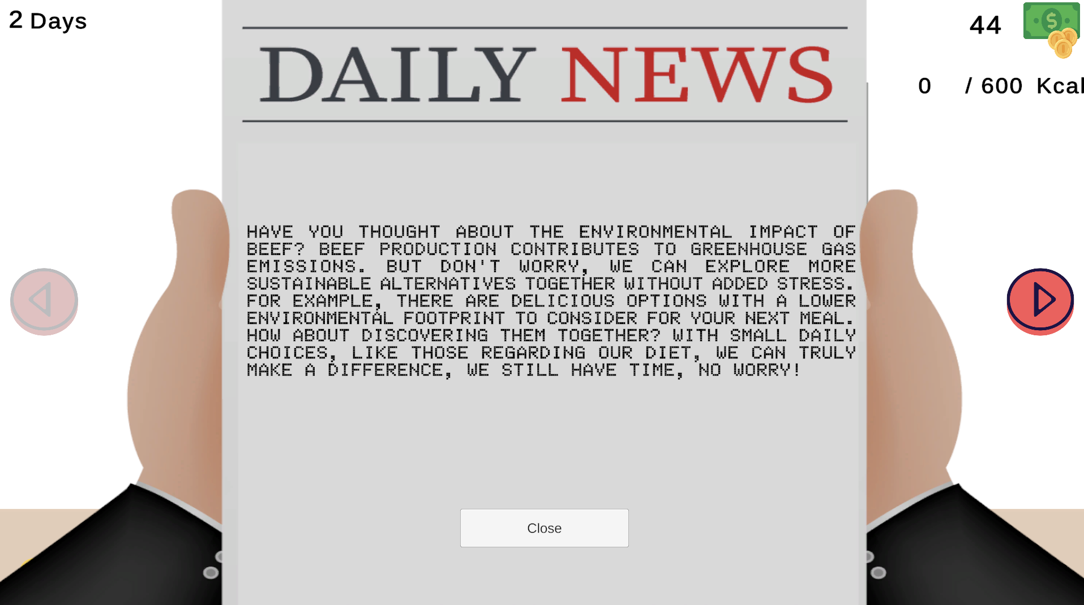
EXAMPLE OF A NEGATIVE EVENT FOR ANXIOUS

Slide 24
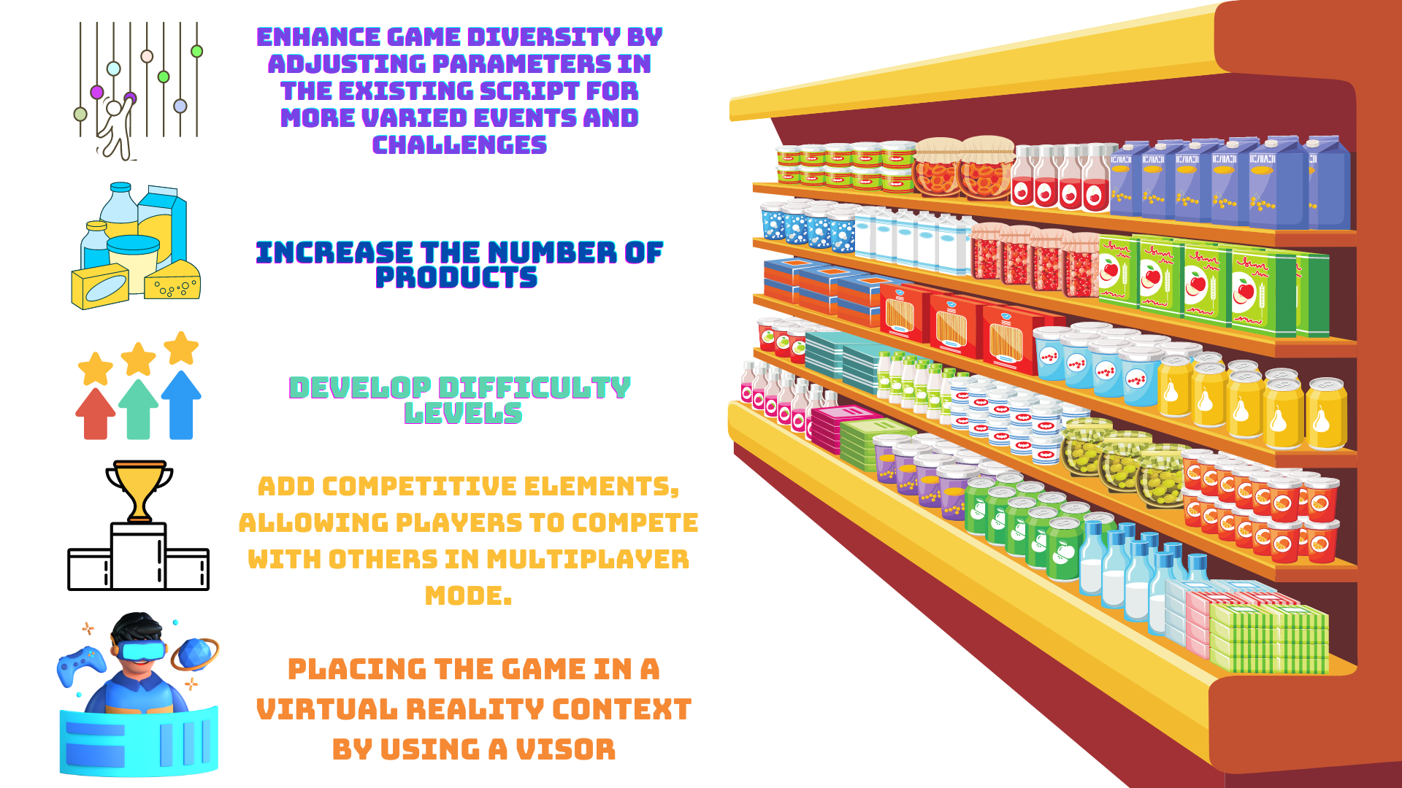
CONCLUSIONS AND FUTURE DEVELOPMENTS

Slide 25


